Slide 1
Cryptography: The Landscape, Fundamental Primitives, and Security
David Brumley
dbrumley@cmu.edu
Carnegie Mellon University

Slide 2
The Landscape
Jargon in Cryptography

Slide 3
Good News: OTP has perfect secrecy
Thm: The One Time Pad is Perfectly Secure
Must show:
where |M| = {0,1}^{m}
Proof:
\begin{align}
\Pr[E(k,m_0) = c] &= \Pr[k \oplus m_0 = c] \\
& = \frac{|k \in \{0,1\}^m : k \oplus m_0 = c|}{\{0,1\}^m}\\
& = \frac{1}{2^m}\\
\Pr[E(k,m_1) = c] &= \Pr[k \oplus m_1 = c] \\
& = \frac{|k \in \{0,1\}^m : k \oplus m_1 = c|}{\{0,1\}^m}\\
& = \frac{1}{2^m}
\end{align}
Therefore, $\Pr[E(k,m_0) = c] = \Pr[E(k,m_1) = c]$
Information-Theoretic Secrecy
Notes:
In this proof, highlight that we are given c.
Then we fix an m_0.
The probability that that m_0 is encrypted to c is the number of unique keys that would map m to c.
By the previous slide, we know there is only one such key. So the probability E(k,m_0) = C = ½^m
Similarly for Pr[E(k,m_1).

Slide 4
The “Bad News” Theorem
Theorem: Perfect secrecy requires |K| >= |M|
Notes:
Computational security means two different things here. There is the notion of “enough” security, e.g., it would take 2^80 years to crack the cipher with todays technology. There is also a theoretic notion, e.g., no polynomial time algorithm could break the cipher.
What this means is the OTP is really the best we can do.

Slide 5
Kerckhoffs’ Principle
The system must be practically, if not mathematically, indecipherable
Security is only preserved against efficient adversaries running in (probabilistic) polynomial time (PPT) and space
Adversaries can succeed with some small probability (that is small enough it is hopefully not a concern)
  Ex: Probability of guessing a password
“A scheme is secure if every PPT adversary succeeds in breaking the scheme with only negligible probability”

Slide 6
The Landscape

Slide 7
Pseudorandom Number Generators
Amplify small amount of randomness to large “pseudo-random” number with a
pseudo-random number generator (PNRG)
\text{Let~} S: \{0,1\}^s \text{~and~} K: \{0,1\}^k\\
G: S \impl K \text{~where~} k \gg s
Notes:
Note that s is small, and k is large. Also note that there is a periodicity: you can’t use a PRNG forever without reseeding.
It’s also deteministic; if you know the seed, you can compute the output.

Slide 8
One Way Functions
Defn: A function f is one-way if:
  f can be computed in polynomial time
  No polynomial time adversary A can invert with more than negligible probability
Note: mathematically, a function is one-way if it is not one-to-one. Here we mean something stronger.

Slide 9
Candidate One-Way Functions
Factorization. Let N=p*q, where |p| = |q| = |N|/2. We believe factoring N is hard.
Discrete Log. Let p be a prime, x be a number between 0 and p. Given g^{x} mod p, it is believed hard to recover x.

Slide 10
The relationship
PRNG exist ⬄ OWF exist

Slide 11
Thinking About Functions
A function is just a mapping from inputs to outputs:
f₁
f₂
f₃
x | f₁(x)
1 | 4
2 | 13
3 | 12
4 | 1
5 | 7
x | f₂(x)
1 | 1
2 | 2
3 | 3
4 | 4
5 | 5
x | f₂(x)
1 | 12
2 | 3
3 | 7
4 | 8
5 | 10
...
Which function is not random?
Notes:
This question does not make sense.

Slide 12
Thinking About Functions
A function is just a mapping from inputs to outputs:
f₁
f₂
f₃
x | f₁(x)
1 | 4
2 | 13
3 | 12
4 | 1
5 | 7
x | f₂(x)
1 | 1
2 | 2
3 | 3
4 | 4
5 | 5
x | f₂(x)
1 | 12
2 | 3
3 | 7
4 | 8
5 | 10
...
What is random is the way we pick a function
Notes:
This question does not make sense.

Slide 13
Game-based Interpretation
Random Function
Fill in random value
x | f₁(x)
1
2
3
4
5
6
Query x=3
Query f(x)=2
Note asking x=1, 2, 3, ... gives us our OTP randomness.
Notes:
Initially function is empty (usually denoted by bottom).
A query comes in for x, and we fill in a random value. We then output the random value as f(x).
Keep doing this again and again.

Slide 14
PRFs
Pseudo Random Function (PRF) defined over (K,X,Y):
such that there exists an “efficient” algorithm to evaluate F(k,x)
X
F(k,⋅), k ∊ K
Y
Notes:
PRF is defined over input space X, output space Y, and a key space K. It’s a function that takes a key and an input and outputs an element in the output space. The only requirement is that F is efficiently computable, (i.e., not required to be invertible)

Slide 15
Pseudorandom functions are not to be confused with pseudorandom generators (PRGs). The guarantee of a PRG is that a single output appears random if the input was chosen at random. On the other hand, the guarantee of a PRF is that all its outputs appear random, regardless of how the corresponding inputs were chosen, as long as the function was drawn at random from the PRF family.
- wikipedia

Slide 16
PRNG exist ⬄ OWF exist ⬄ PRF exists

Slide 17
Abstractly: PRPs
Pseudo Random Permutation (PRP) defined over (K,X)
such that:
Exists “efficient” deterministic algorithm to evaluate E(k,x)
The function E(k, ∙) is one-to-one
Exists “efficient” inversion algorithm D(k,y)
X
X
E(k,⋅), k ∊ K
D(k, ⋅), k ∊ K
Notes:
Now that E(k,.) is one to one, what does that buy us?

Slide 18
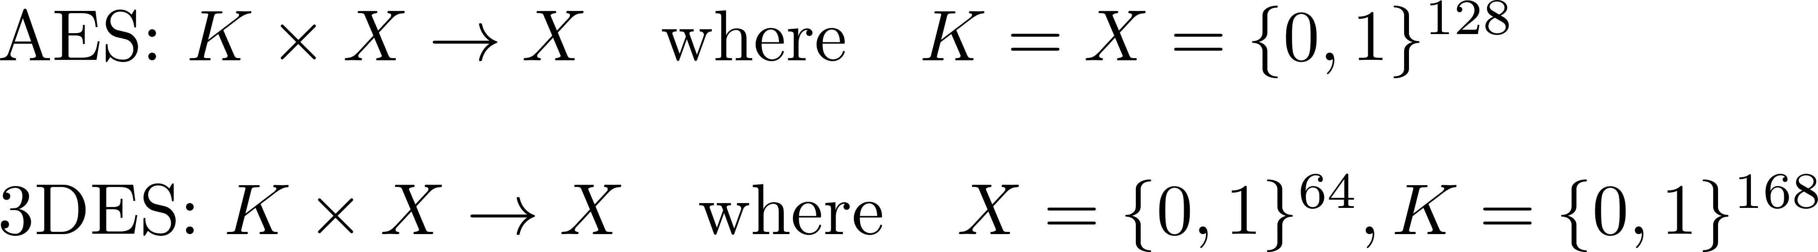
Running example
Example PRPs: 3DES, AES, …
Functionally, any PRP is also a PRF.
- PRP is a PRF when X = Y and is efficiently invertible
Notes:
PRP is equal to Block cipher. Thus, whenever I say PRP you can think of AES or 3des.
Every prp is a prf with more structure: i.e., input and output space are the same, and it is efficiently invertible (once the secret key k is known)

Slide 19
The Landscape

Slide 20
Security and Indistinguishability

Slide 21
Kerckhoffs’ Principle
The system must be practically, if not mathematically, indecipherable
Security is only preserved against efficient adversaries running in polynomial time and space
Adversaries can succeed with some small probability (that is small enough it is hopefully not a concern)
  Ex: Probability of guessing a password
“A scheme is secure if every PPT adversary succeeds in breaking the scheme with only negligible probability”

Slide 22
A Practical OTP
k
PRNG expansion
G(k)
m
c

Slide 23
Question
Can a PRNG-based pad have perfect secrecy?
Yes, if the PRNG is secure
No, there are no ciphers with perfect secrecy
No, the key size is shorter than the message
Notes:
The answer is number 3.

Slide 24
PRG Security
Recall PRNG:
One requirement: Output of PRG is unpredictable (mimics a perfect source of randomness)
It should be impossible for any Alg to predict bit i+1 given the first i bits:
\exists i. G(k)|_{1,\ldots,i} \xrightarrow{\text{Alg}} G(k)|_{i+1,\ldots,n}
Even predicting 1 bit is insecure

Slide 25
Example
Suppose PRG is predictable:
predict these bits of insecure G
\exists i. G(k)|_{1,\ldots,i} \xrightarrow{\text{Alg}} G(k)|_{i+1,\ldots,n}
G(k)
i bits
gives i bits
m
From
c
From

Slide 26
Adversarial Indistinguishability Game
E
A
Challenger:
I have a
secure PRF. It’s just like real randomness!
I am any adversary. You can’t fool me.
Notes:
I’m taking the notion of adversarial indistinguishability here first. It’s defined on p33 of Introduction to Modern Cryptography

Slide 27
Secure PRF: The Intuition
PRF
Real Random Function
Barrier
A
Notes:
Intuition: The adversary is given either a real random function or a PRF. he can ask any query. At the end of the game, he can’t tell which he was give.

Slide 28
PRF Security Game
(A behavioral model)
World 0
World 1
E
2.
if(tbl[x]
undefined)
tbl[x] = rand()
return y =tbl[x]
A
1. Picks x
5. Guess and output b’
E
y = PRF(x)
A
1. Picks x
3. Outputs guess for b
x
x
y
y
A doesn’t know which world he is in, but wants to figure it out.
For b=0,1: W_{b} := [ event that A(W_{b}) =1 ]
Adv_{SS}[A,E] := | Pr[ W₀ ] − Pr[ W₁ ] | ∈ [0,1]
Always 1
Notes:
Walk through this slowly. If A(Wb) = 1 for World 0, then the adversary has guessed incorrectly. If A(Wb) = 1 in world 1, then the adversary is correct. Thus, the probability is counting the number of
This model is a behavioral model, i.e., says that the adversary behaves the same regardless of which world he is in.
Behavioral is important

Slide 29
Secure PRF: An Alternate Interpretation
For b = 0,1 define experiment EXP(b) as:
Def: PRF is a secure PRF if for all efficient A:
Challenger
F
Adversary

Slide 30
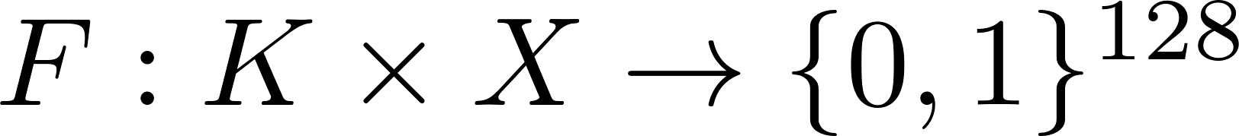
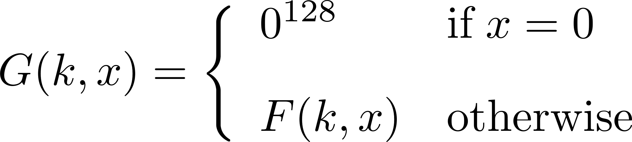
Quiz
Let be a secure PRF.
Is the following G a secure PRF?
No, it is easy to distinguish G from a random function
Yes, an attack on G would also break F
It depends on F
Notes:
Suppose we have a secure PRF F (it outputs 128 bits). F cannot be distinguished from a truly random function. Let’s construct a new PRF G as follows: if x == 0 output 0 otherwise output F. Is G also a secure prf?
No it’s not. Just submit x=0 probability of random function to return 0 is 1/2^128, for G it’s always 0
Thus, if only a single output of a PRF if fixed/known the PRF cannot be secure

Slide 31
Semantic Security of Ciphers

Slide 32
What is a secure cipher?
Attackers goal: recover one plaintext (for now)
Attempt #1: Attacker cannot recover key
Attempt #2: Attacker cannot recover all of plaintext
Insufficient: E(k,m) = m
Insufficient: E(k,m₀ || m₁) = m₀ || E(k,m₁)
Recall Shannon’s Intuition:
c should reveal no information about m

Slide 33
Adversarial Indistinguishability Game
E
A
Challenger:
I have a
secure cipher E
I am any adversary. I can break your crypto.
Notes:
I’m taking the notion of adversarial indistinguishability here first. It’s defined on p33 of Introduction to Modern Cryptography

Slide 34
Semantic Security Motivation
E
A
2. Challenger encrypts one at random. Sends back c.
4. Challenger wins of A is no better than guessing
m₀,m₁
1. A sends m₀, m₁ s.t.
|m₀|=|m₁|to the challenger
3. A tries to guess which message was encrypted.
c
Semantically secure
Notes:
In this slide we introduce a powerful notion. Note:
- Power of adversary (chooses any messages).
- Doesn’t have to decrypt, find key, etc. Just determine which message was encrypted.
This is a very stringent notion.

Slide 35
Semantic Security Game
World 0
World 1
E
2. Pick b=0
3. k=KeyGen(l)
4. c = E(k,m_{b})
A
1. Picks
m₀, m₁,
|m₀| = |m₁|
5. Guess and output b’
E
2. Pick b=1
3. k=KeyGen(l)
4. c = E(k,m_{b})
A
1. Picks
m₀, m₁,
|m₀| = |m₁|
5. Guess and output b’
m₀,m₁
m₀,m₁
c
c
A doesn’t know which world he is in, but wants to figure it out.
Semantic security is a behavioral model getting at any A behaving the same in either world when E is secure.

Slide 36
Semantic Security Game
(A behavioral model)
World 0
World 1
E
2. Pick b=0
3. k=KeyGen(l)
4. c = E(k,m_{b})
A
1. Picks
m₀, m₁,
|m₀| = |m₁|
5. Guess and output b’
E
2. Pick b=1
3. k=KeyGen(l)
4. c = E(k,m_{b})
A
1. Picks
m₀, m₁,
|m₀| = |m₁|
5. Guess and output b’
m₀,m₁
m₀,m₁
c
c
A doesn’t know which world he is in, but wants to figure it out.
For b=0,1: W_{b} := [ event that A(W_{b}) =1 ]
Adv_{SS}[A,E] := | Pr[ W₀ ] − Pr[ W₁ ] | ∈ [0,1]
Always 1
Notes:
Walk through this slowly. If A(Wb) = 1 for World 0, then the adversary has guessed incorrectly. If A(Wb) = 1 in world 1, then the adversary is correct. Thus, the probability is counting the number of
This model is a behavioral model, i.e., says that the adversary behaves the same regardless of which world he is in.
Behavioral is important

Slide 37
Example 1: Guessing
World 0
World 1
E
2. Pick b=0
3. k=KeyGen(l)
4. c = E(k,m_{b})
A
1. Picks
m₀, m₁,
|m₀| = |m₁|
5. Guess and output b’
E
2. Pick b=1
3. k=KeyGen(l)
4. c = E(k,m_{b})
A
1. Picks
m₀, m₁,
|m₀| = |m₁|
5. Guess and output b’
m₀,m₁
m₀,m₁
c
c
A guesses. W_{b} := [ event that A(W_{b}) =1 ]. So
W₀ = .5, and W₁ = .5
Adv_{SS}[A,E] := | .5 − .5 | = 0
Notes:
Walk through this slowly. If A(Wb) = 1 for World 0, then the adversary has guessed incorrectly. If A(Wb) = 1 in world 1, then the adversary is correct. Thus, the probability is counting the number of
This model is a behavioral model, i.e., says that the adversary behaves the same regardless of which world he is in.

Slide 38
Example 1: A is right 75% of time
World 0
World 1
E
2. Pick b=0
3. k=KeyGen(l)
4. c = E(k,m_{b})
A
1. Picks
m₀, m₁,
|m₀| = |m₁|
5. Guess and output b’
E
2. Pick b=1
3. k=KeyGen(l)
4. c = E(k,m_{b})
A
1. Picks
m₀, m₁,
|m₀| = |m₁|
5. Guess and output b’
m₀,m₁
m₀,m₁
c
c
A guesses. W_{b} := [ event that A(W_{b}) =1 ]. So
W₀ = .25, and W₁ = .75
Adv_{SS}[A,E] := | .25 − .75 | = .5
Notes:
Walk through this slowly. If A(Wb) = 1 for World 0, then the adversary has guessed incorrectly. If A(Wb) = 1 in world 1, then the adversary is correct. Thus, the probability is counting the number of
This model is a behavioral model, i.e., says that the adversary behaves the same regardless of which world he is in.

Slide 39
Example 1: A is right 25% of time
World 0
World 1
E
2. Pick b=0
3. k=KeyGen(l)
4. c = E(k,m_{b})
A
1. Picks
m₀, m₁,
|m₀| = |m₁|
5. Guess and output b’
E
2. Pick b=1
3. k=KeyGen(l)
4. c = E(k,m_{b})
A
1. Picks
m₀, m₁,
|m₀| = |m₁|
5. Guess and output b’
m₀,m₁
m₀,m₁
c
c
A guesses. W_{b} := [ event that A(W_{b}) =1 ]. So
W₀ = .75, and W₁ = .25
Adv_{SS}[A,E] := | .75 − .25 | = .5
Note for W₀, A is wrong more often than right. A should switch guesses.
Notes:
Walk through this slowly. If A(Wb) = 1 for World 0, then the adversary has guessed incorrectly. If A(Wb) = 1 in world 1, then the adversary is correct. Thus, the probability is counting the number of
This model is a behavioral model, i.e., says that the adversary behaves the same regardless of which world he is in.

Slide 40
Semantic Security
Given:
For b=0,1: W_{b} := [ event that A(W_{b}) =1 ]
Adv_{SS}[A,E] := | Pr[ W₀ ] − Pr[ W₁ ] | ∈ [0,1]
Defn:
E is semantically secure if for all efficient A:
Adv_{SS}[A, E] is negligible.
⇒ for all explicit m₀ , m₁ ∈ M :
{ E(k,m₀) } ≈_{p} { E(k,m₁) }
This is what it means to be secure against eavesdroppers. No partial information is leaked

Slide 41
Something we believe is hard, e.g., factoring
Something we want to show is hard.
Problem
A
Problem
B
Easier
Harder

Slide 42
Proving Security

Slide 43
Security Reductions
Reduction: Problem A is at least as hard as B if an algorithm for solving A efficiently (if it existed) could also be used as a subroutine to solve problem B efficiently.
Crux: We don’t believe A exists, so B must be secure
(contra-positive proof technique)
B
Instance i problem B
Instance j for problem A
A
Solution to i
Break

Slide 44
Example
Reduction: Problem Factoring (A) is at least as hard as RSA (B) if an algorithm for solving Factoring (A) efficiently (if it existed) could also be used as a subroutine to solve problem RSA (B) efficiently.
RSA
Ciphertext c, N
N
Factoring
Plaintext m
p,q s.t. N = p*q

Slide 45
What’s unknown...
Reduction: Problem RSA (A) is at least as hard as Factoring (B) if an algorithm for solving RSA (A) efficiently (if it existed) could also be used as a subroutine to solve problem Factoring (B) efficiently.
Synthesize p,q from just c, m, and N?
RSA
N
c, N
RSA
...
m

Slide 46
Games and Reductions
Guess It!
m = 1...10
k=KeyGen(l)
c = E(k,m)
A
c
bet
bet =?= m
Suppose A is in a guessing game. Guess It! uses E to encrypt. How can we prove, in this setting, that E is secure?
Reduction: If A does better than 1/10, we break E in the semantic security game. Showing security of E reduces to showing if A exists, it could break the semantic security game. (Equivalently, if E is semantically secure, then the probability A wins is at most 10%.)
Note: The “type” of A is A: c -> bet

Slide 47
Idea
Reduction: We build an adversary B that uses A as a subroutine. Our adversary B has the property if A wins at Guess It! with probability significantly greater than 10%, B will have a non-negligible advantage in our semantic security game.
  If E secure, Guess It! is secure.
  Equivalently, if Guess It! insecure, E is insecure

Slide 48
The Real Version
Guess It!
m = 1...10
k=KeyGen(l)
c = E(k,m)
A
c
bet
bet =?= m
In the real version, A always gets an encryption of the real message.
  Pr[A wins in real version] = p₀

Slide 49
Idealized Version
Guess It!
m = 1...10
k=KeyGen(l)
c = E(k,0)
A
c
bet
bet =?= m
In the ideal version, A always gets an encryption of a constant, say 1. (A still only wins if it gets m correct.)
  Pr[A wins in Idealized Version] = p₁ = 1/10

Slide 50
Reduction
World b = {0,1}
E
2. m_{b} = b
3. k=KeyGen(l)
4. c = E(k,m_{b})
B
r = random 1,...,10
m₀ = r
m₁ = 1 (const)
m₀,m₁
A
c
bet
b’ = (r == bet)
If B is in world 0, then Pr[b’ = 1] = p₀
  B can guess r==bet with prob. p₀.
If B is in world 1, then Pr[b’ = 1] = p₁ = 1/10
For b=0,1: W_{b} := [ event that B(W_{b}) =1 ]
Adv_{SS}[A,E] = | Pr[ W₀ ] − Pr[ W₁ ] |
= |p₀ – p₁|

Slide 51
Reduction
World b = {0,1}
E
2. m_{b} = b
3. k=KeyGen(l)
4. c = E(k,m_{b})
B
r = random 1,...,10
m₀ = r
m₁ = 1 (const)
m₀,m₁
A
c
bet
b’ = (r == bet)
If B is in world 0, then Pr[b’ = 1] = p₀
  B can guess r==bet with prob. p₀.
If B is in world 1, then Pr[b’ = 1] = p₁ = 1/10
For b=0,1: W_{b} := [ event that B(W_{b}) =1 ]
Adv_{SS}[A,E] = | Pr[ W₀ ] − Pr[ W₁ ] |
= |p₀ – p₁|
Suppose 33% correct
33%-%10 = 23% Advantage

Slide 52
Reduction Example 2
Suppose efficient A can always deduce LSB of PT from CT. Then E = (E,D) is not semantically secure.
World b
E
2. m_{b} = b
3. k=KeyGen(l)
4. c = E(k,m_{b})
B (we construct)
m₀ = LSB(m₀) = 0
m₁ = LSB(m₁) = 1
m₀,m₁
A (given)
c
g = LSB(m)
b’ = g
Adv_{SS}[A,E] = | Pr[ W₀ ] − Pr[ W₁ ] | = |0 – 1| = 1
Notes:
The same holds for any predicate P that you can calculate efficiently.

Slide 53

Questions?

Slide 54
END

Slide 55
Thought

Slide 56
The “Bad News” Theorem
Theorem: Perfect secrecy requires |K| >= |M|
And what about integrity and authenticity?
In practice, we usually shoot for
computational security.
Notes:
Computational security means two different things here. There is the notion of “enough” security, e.g., it would take 2^80 years to crack the cipher with todays technology. There is also a theoretic notion, e.g., no polynomial time algorithm could break the cipher.
What this means is the OTP is really the best we can do.

Slide 57
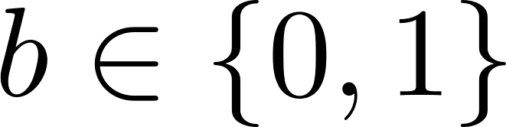
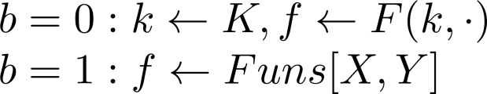
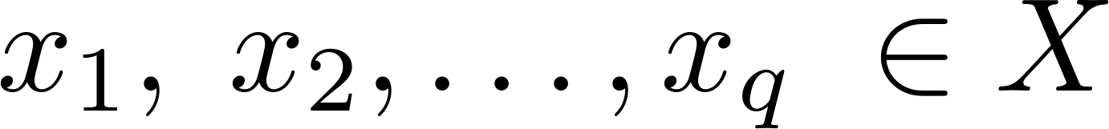
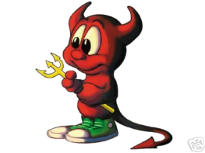
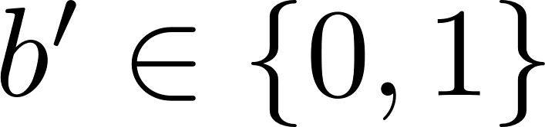
Secure PRF: Definition
For b = 0,1 define experiment EXP(b) as:
Def: F is a secure PRF if for all “efficient” A:
is “negligible”.
Chal.
f
Adv. A
Adv definition not pretty.
EXP(b)
Notes:
Adversary tries to distinguish a truly random function from a pseudo random function. Attacker submits points x \in X and receives either f(x) or F(k,x) (consistently, i.e., always either f(x) or F(k,x)) That is, the adversary is either interacting with a PRF or a truly random function.

Slide 58
Quiz
Let be a secure PRF.
Is the following G a secure PRF?
No, it is easy to distinguish G from a random function
Yes, an attack on G would also break F
It depends on F
Notes:
Suppose we have a secure PRF F (it outputs 128 bits). F cannot be distinguished from a truly random function. Let’s construct a new PRF G as follows: if x == 0 output 0 otherwise output F. Is G also a secure prf?
No it’s not. Just submit x=0 probability of random function to return 0 is 1/2^128, for G it’s always 0
Thus, if only a single output of a PRF if fixed/known the PRF cannot be secure

Slide 59
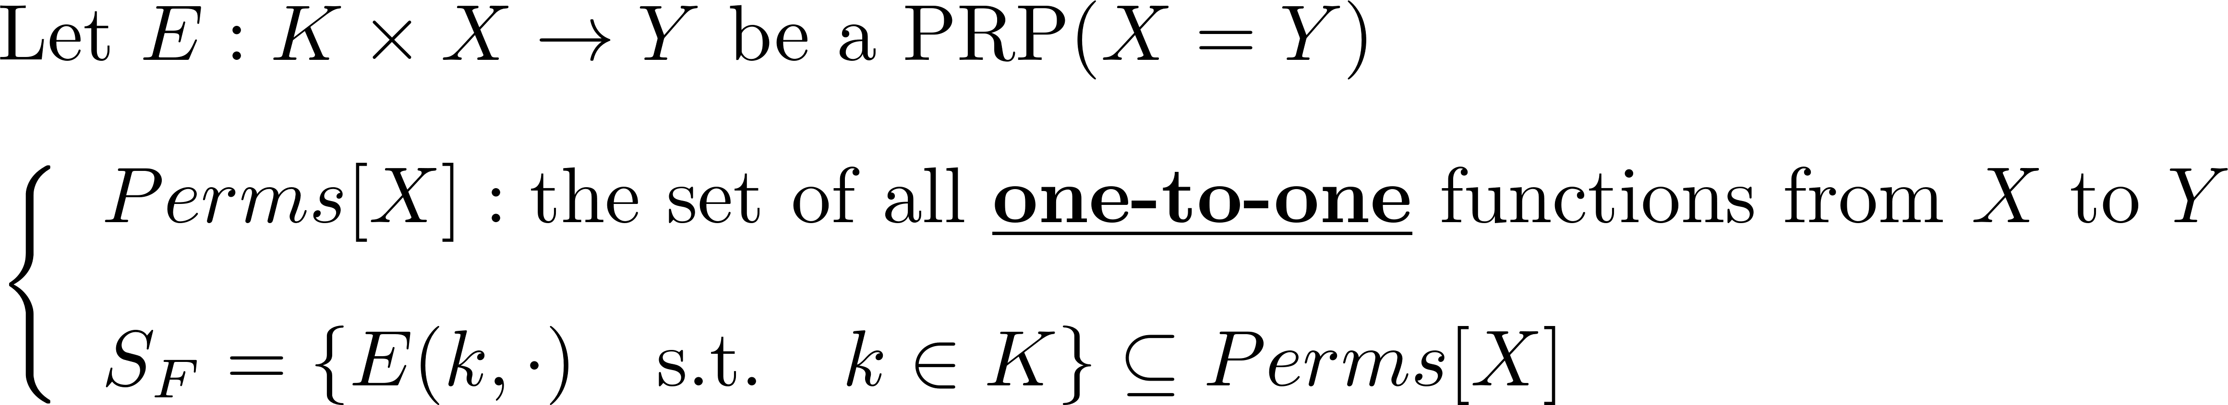
Secure PRPs (secure block cipher)
Intuition: a PRP is secure if
  A random function in Perms[X] is indistinguishable from a random function in S_{F}
Notes:
Size of Funs for AES128 = 2^(128 * 2 ^ 128) |S_AES| = 2^128

Slide 60
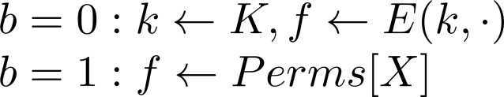
Secure PRP: (secure block cipher)
For b = 0,1 define experiment EXP(b) as:
Def: E is a secure PRP if for all “efficient” A:
is “negligible”.
Chal.
f
Adv. A
same font/spacing problem here.
EXP(b)
Notes:
{\color{red}Adv_{PRP}[A, E] := | Pr[EXP(0) = 1] - Pr[EXP(1) = 1]|}

Slide 61
Modern Notions: Indistinguishability and Semantic Security

