Slide 1


David Brumley
Carnegie Mellon University
Credit: Some slides from Ed Schwartz

Slide 2
Control Flow Hijack:
Always control + computation
shellcode (aka payload) | padding | &buf
computation + control
Return-oriented programming (ROP): shellcode without code injection

Slide 3
Motivation: Return-to-libc Attack
ptr to
“/bin/sh”
…
argv
argc
return addr
caller’s ebp
buf (64 bytes)
argv[1]
buf
ret transfers control to system, which finds arguments on stack
&system
Overwrite return address with address of libc function
setup fake return address and argument(s)
ret will “call” libc function
No injected code!
%ebp
%esp

Slide 4
What if we don’t know the address of system?
Use existing application logic that does!

Slide 5
ptr to
“/bin/sh”
…
argv
argc
return addr
caller’s ebp
buf (64 bytes)
argv[1]
buf
What if we don’t know the absolute address any pointers to “/bin/sh”
(objdump gives addresses, but we don’t know ASLR constants)
&system
%ebp
%esp

Slide 6
ptr to
“/bin/sh”
…
argv
argc
return addr
caller’s ebp
buf (64 bytes)
argv[1]
buf
Need to find an instruction sequence, aka gadget, with esp
&system
%ebp
%esp

Slide 7
Scorecard for ret2libc
No injected code ➔ DEP ineffective
Requires knowing address of system
... or does it.

Slide 8
Gadget Examples
Save address of esp
Execute our own shellcode
Shacham: gadgets are Turing-complete
xor ecx, ecx
mul ecx
push ecx
push 0x68732f2f
push 0x6e69622f
mov ebx, esp
mov al, 0xb
int 0x80
Our example shellcode
The trick is to find the desired instruction sequences, or semantically equivalent ones

Slide 9
Return Oriented Programming Techniques
Geometry of Flesh on the Bone, Shacham et al, CCS 2007

Slide 10
ROP Programming
Disassemble code
Identify useful code sequences as gadgets
Assemble gadgets into desired shellcode

Slide 11
There are many semantically equivalent ways to achieve the same net shellcode effect

Slide 12
Equivalence
...
v₂
...
v₁
Mem[v2] = v1
Desired Logic
esp
Stack
a₁: mov eax, [esp]
a₂: mov ebx, [esp+8]
a₃: mov [ebx], eax
Implementation 1

Slide 13
Gadgets
A gadget is any instruction
sequence ending with ret

Slide 14
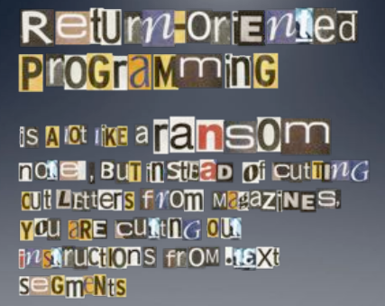
Image by Dino Dai Zovi

Slide 15
ROP Overview
Idea: We forge shell code out of existing application logic gadgets
Requirements:
vulnerability + gadgets + some unrandomized code
History:
  No code randomized: Code injection
  DEP enabled by default: ROP attacks using libc gadgets publicized ~2007
  Libc randomized
  ASLR library load points
  Q builds ROP compiler using .text section
  Today: Windows 7 compiler randomizes text by default, Randomizing text on Linux not straight-forward.

Slide 16
Gadgets
a₅
v₂
a₃
v₁
Mem[v2] = v1
Desired Logic
Suppose a₂ and a₃ on stack
esp
Stack
a₁: pop eax;
a₂: ret
a₃: pop ebx;
a₄: ret
a₅: mov [ebx], eax
eax
ebx
eip
v₁
a₁
Implementation 2

Slide 17
Gadgets
a₅
v₂
a₃
v₁
Mem[v2] = v1
Desired Logic
esp
Stack
a₁: pop eax;
a₂: ret
a₃: pop ebx;
a₄: ret
a₅: mov [ebx], eax
eax
ebx
eip
v₁
a₁
a₃
Implementation 2

Slide 18
Gadgets
a₅
v₂
a₃
v₁
Mem[v2] = v1
esp
Desired Logic
Stack
a₁: pop eax;
a₂: ret
a₃: pop ebx;
a₄: ret
a₅: mov [ebx], eax
eax
ebx
eip
v₁
v₂
a₃
Implementation 2

Slide 19
Gadgets
a₅
v₂
a₃
v₁
esp
Mem[v2] = v1
Desired Logic
Stack
a₁: pop eax;
a₂: ret
a₃: pop ebx;
a₄: ret
a₅: mov [ebx], eax
eax
ebx
eip
v₁
v₂
a₄
a₅
Implementation 2

Slide 20
Gadgets
esp
a₅
v₂
a₃
v₁
Mem[v2] = v1
Desired Logic
Stack
a₁: pop eax;
a₂: ret
a₃: pop ebx;
a₄: ret
a₅: mov [ebx], eax
eax
ebx
eip
v₁
v₂
a₅
Implementation 2

Slide 21
Equivalence
a₃
v₂
a₂
v₁
Mem[v2] = v1
Desired Logic
semantically equivalent
esp
Stack
“Gadgets”
a₁: mov eax, [esp]
a₂: mov ebx, [esp+8]
a₃: mov [ebx], eax
a₁: pop eax; ret
a₂: pop ebx; ret
a₃: mov [ebx], eax
Implementation 1
Implementation 2

Slide 22
Equivalence
a₃
v₂
a₂
v₁
Mem[v2] = v1
Desired Logic
Address
independent!
Stack
a₁: pop eax; ret
...
a₃: mov [ebx], eax
...
a₂: pop ebx; ret
a₁: pop eax; ret
a₂: pop ebx; ret
a₃: mov [ebx], eax
Implementation 2

Slide 23
Return-Oriented Programming (ROP)
…
argv
argc
return addr
caller’s ebp
buf (64 bytes)
argv[1]
buf
Mem[v2] = v1
Desired Shellcode
%ebp
Find needed instruction gadgets at addresses a₁, a₂, and a₃ in existing code
Overwrite stack to execute a₁, a₂, and then a₃
%esp

Slide 24
Return-Oriented Programming (ROP)
a₃
v₂
a₂
v₁
a₁
…
argv
argc
return addr
caller’s ebp
buf (64 bytes)
argv[1]
buf
Mem[v2] = v1
Desired Shellcode
%ebp
a₁: pop eax; ret
a₂: pop ebx; ret
a₃: mov [ebx], eax
Desired store executed!
%esp

Slide 25
Quiz
void foo(char *input){
char buf[512];
...
strcpy (buf, input);
return;
}
a₁: add eax, 0x80; pop %ebp; ret
a₂: pop %eax; ret
Draw a stack diagram and ROP exploit to pop a value 0xBBBBBBBB
into eax and add 80.
ret at a₃
Known
Gadgets

Slide 26
Quiz
void foo(char *input){
char buf[512];
...
strcpy (buf, input);
return;
}
a₁: add eax, 0x80; pop %ebp; ret
a₂: pop %eax; ret
<data for pop ebp>
a₃
0xBBBBBBBB
a₂
a₃
saved ebp
buf
ret at a₃
Start rop chain
gadget 1 + data
Overwrite buf
gadget 2
AAAAA ... a₃ a₂ 0xBBBBBBBB a₁

Slide 27
Example in 04-exercises
Notes:
See notes onenote dairy

Slide 28
Attack Surface: Linux
Unrandomized
Randomized
Libc
Program Image
Stack
Heap
Notes:
Let’s look at the ASLR implementation in Linux as an example

Slide 29
Attack Surface: Windows
Unrandomized
Randomized
Program Image
Libc
Stack
Heap
Notes:
Let’s look at the ASLR implementation in Linux as an example

Slide 30
Save esp into edi
Make a copy in eax
gadgets to compute ptr to
“/bin/sh”
Gadget 1
push %esp
mov %eax, %edx
pop %edi
ret
Gadget 2
push %edi
pop %eax
pop %ebp
ret
…
argv
argc
return addr
caller’s ebp
buf “/bin/sh”
argv[1]
buf
&system
%ebp
Useful, for example, to get a copy of ESP. If we know relative offset of ptr to esp, we can know use that relative offset knowledge to locate a pointer. (e.g., find more gadgets that add offset and store result to stack.)
This overcomes ASLR because ASLR only protects against knowing absolute addresses.
%esp
Notes:
Useful, for example, to get a copy of ESP. If we know relative offset of ptr to esp, we can know use that relative offset knowledge to locate a pointer.
This overcomes ASLR because ASLR only protects against knowing absolute addresses.

Slide 31
LPVOID WINAPI VirtualProtect(
LPVOID lpAddress, // base addr to pages to change
SIZE_T dwSize, // size of the region in bytes
DWORD DWORD flNewProtect, // 0x40 = EXECUTE_READWRITE
DWORD flProtect // A ptr to a variable for prev. arg
);
VirtualProtect() to un-DEP memory region

Slide 32
Practical Matters
Stack pivots: point esp at heap, e.g., because we control heap data.
See https://www.corelan.be/index.php/2010/06/16/exploit-writing-tutorial-part-10-chaining-dep-with-rop-the-rubikstm-cube/

Slide 33
Disassembling Code

Slide 34
Recall: Execution Model
Process
Memory
Fetch, decode, execute
Code
Processor
EIP
Stack
Heap
read and write

Slide 35
Disassembly
user@box:~/l2$ objdump -d ./file
...
00000000 <even_sum>:
0: 55 push %ebp
1: 89 e5 mov %esp,%ebp
3: 83 ec 10 sub $0x10,%esp
6: 8b 45 0c mov 0xc(%ebp),%eax
9: 03 45 08 add 0x8(%ebp),%eax
c: 03 45 10 add 0x10(%ebp),%eax
f: 89 45 fc mov %eax,0xfffffffc(%ebp)
12: 8b 45 fc mov 0xfffffffc(%ebp),%eax
15: 83 e0 01 and $0x1,%eax
18: 84 c0 test %al,%al
1a: 74 03 je 1f <even_sum+0x1f>
1c: ff 45 fc incl 0xfffffffc(%ebp)
1f: 8b 45 fc mov 0xfffffffc(%ebp),%eax
22: c9 leave
23: c3 ret
Disassemble
Address
Executable instructions

Slide 36
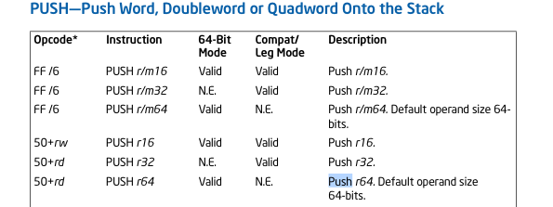
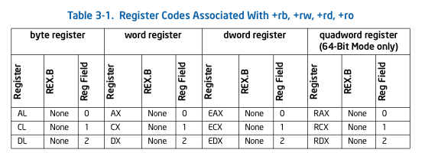
Linear-Sweep Disassembly
Executable Instructions
0x55 | 0x89 | 0xe5 | 0x83 | 0xec | 0x10 | ... | 0xc9
Disassembler
EIP
Algorithm:
Decode Instruction
Advance EIP by len
push ebp

Slide 37
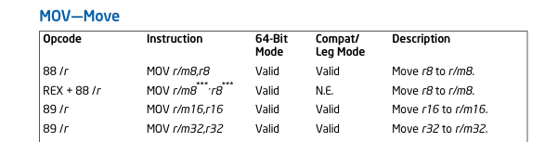
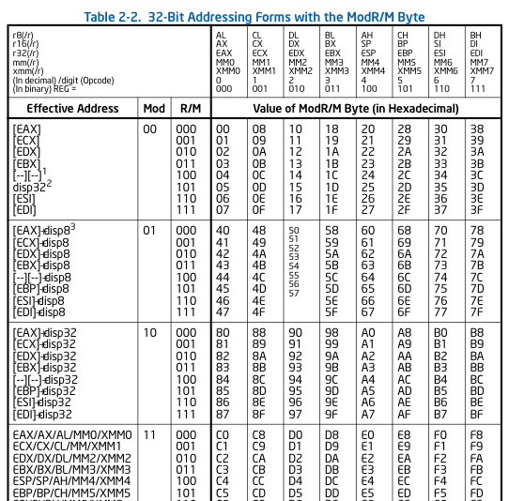
Linear-Sweep Disassembly
Executable Instructions
0x55 | 0x89 | 0xe5 | 0x83 | 0xec | 0x10 | ... | 0xc9
Disassembler
EIP
...
push ebp
push ebp
mov %esp, %ebp

Slide 38
Linear-Sweep Disassembly
Executable Instructions
0x55 | 0x89 | 0xe5 | 0x83 | 0xec | 0x10 | ... | 0xc9
Disassembler
EIP
Note we don’t follow jumps: we just increment by instruction length
Algorithm:
Decode Instruction
Advance EIP by len
push ebp
push ebp
mov %esp, %ebp

Slide 39
Disassemble from any address
Normal
Execution
push ebp
mov %esp, %ebp
0x55 | 0x89 | 0xe5 | 0x83 | 0xec | 0x10 | ... | 0xc9
Disassembler
EIP
It’s perfectly valid to start disassembling from
any address.
All byte sequences will have a unique disassembly

Slide 40
Recursive Descent
Follow jumps and returns instead of linear sweep
Undecidable: indirect jumps
  Where does jmp *eax go?

Slide 41
ROP Programming
Disassemble all sequences ending in ret
Disassemble code
Identify useful code sequences ending in ret as gadgets
Assemble gadgets into desired shellcode

Slide 42
Gadgets, Historically
a₃
v₂
a₂
v₁
Mem[v2] = v1
Semantics
a₁: pop eax; ret
...
a₃: mov [ebx], eax
...
a₂: pop ebx; ret
Shacham et al. manually identified which sequences ending in ret in libc were useful gadgets
Common shellcode was created with these gadgets.
Everyone used libc, so gadgets and shellcode universal
Gadgets

Slide 43
ROP: Shacham et al.
Automatic
Disassemble code
Identify useful code sequences as gadgets ending in ret
Assemble gadgets into desired shellcode
Manual
Then Q came along and automated

Slide 44

Questions?

Slide 45
END

Slide 46
Q: Automating ROP
Q: Exploit Hardening Made Easy, Schwartz et al, USENIX Security 2011

Slide 47
Overview*
Executable Code
Q
ROP
Shellcode
Computation
(QooL)
Q Inputs
* Exploit hardening step not discussed here.

Slide 48
Executable Code
Like before
Linear sweep
@ all offsets
Step 1: Disassemble code
Randomized testing of semantics
Step 2: Identify useful code
sequences (not necessarily ending in ret)
Prove semantics
“useful” = Q-Op
Gadget
Database

Slide 49
Q-Ops (aka Q Semantic Types)
(think instruction set architecture)
Q-Op | Semantics | Real World Example
MoveRegG(t₁, t₂) | t₁:= t₂ | xchg %eax, %ebp; ret
LoadConstG(t₁, c) | t₁ := c | pop %ebp; ret
ArithmeticG(t₁, t₂, t₃, op) | t₁ := t₂ op t₃; | add %edx, %eax; ret
LoadMemG(t₁, t₂, c) | t₁:= [t₂ + c] | movl 0x60(%eax), %eax; ret
StoreMemG(t₁,c, t₂) | [t₁+c] := t₂ | mov %dl, 0x13(%eax); ret
ArithmeticLoadG(t₁, t₂, c, op) | t₁ := t₁ op [t₂ + c] | add0x1376dbe4(%ebx), %ecx; (…); ret
ArithmeticStoreG(t₁, t₂, c, op) | [t₁+c] := [t₁+c] op t₂ | add %al, 0x5de474c0(%ebp); ret

Slide 50
Q-Ops (aka Q Semantic Types)
(think instruction set architecture)
Q-Op | Semantics | Real World Example
MoveRegG(t₁, t₂) | t₁:= t₂ | xchg %eax, %ebp; ret
LoadConstG(t₁, c) | t₁ := c | pop %ebp; ret
ArithmeticG(t₁, t₂, t₃, op) | t₁ := t₂ op t₃; | add %edx, %eax; ret
LoadMemG(t₁, t₂, c) | t₁:= [t₂ + c] | movl 0x60(%eax), %eax; ret
StoreMemG(t₁,c, t₂) | [t₁+c] := t₂ | mov %dl, 0x13(%eax); ret
ArithmeticLoadG(t₁, t₂, c, op) | t₁ := t₁ op [t₂ + c] | add0x1376dbe4(%ebx), %ecx; (…); ret
ArithmeticStoreG(t₁, t₂, c, op) | [t₁+c] := [t₁+c] op t₂ | add %al, 0x5de474c0(%ebp); ret
This is not RISC:
more types = more opportunities later
This is not RISC:
more Q-Ops gives more opportunities later
Must be careful attackers, e.g., give c-60 to get c

Slide 51
Executable Code
Randomized testing tells us we likely found a gadget that implements a Q-Op
  Fast: filters out many candidates
  Enables more expensive second stage
Linear sweep
@ all offsets
Randomized testing of semantics
Prove semantics
Gadget
Database

Slide 52
Randomized Testing Example
EAX | 0x0298a7bc
CF | 0x1
ESP | 0x81e4f104
Semantically
EAX := CF
(MoveRegG)
Before
Simulation
What does this do?
sbb %eax, %eax; neg %eax; ret
Probably
EAX | 0x1
ESP | 0x81e4f108
CF | 0x1
After
Simulation

Slide 53
Executable Code
Linear sweep
@ all offsets
Randomized testing of semantics
Turn
probably into a proof
that a gadget
implements a Q-Op
Prove semantics
Gadget
Database

Slide 54
Proving equivalence
eax := eax-(eax+CF)
eax := -eax
esp := esp+4
sbb %eax, %eax;
neg %eax; ret
Assembly
BAP
Weakest
Precondition
(eax = eax-(eax+CF)
eax = -eax
esp = esp+4)
==
(EAX = CF)
Semantic
Gadget
EAX := CF
Yes/No
Prover

Slide 55
Proving Equivalence
Weakest precondition [Dijkstra76] is an algorithm for reducing a program to a statement in logic
  Q uses predicate logic
Satisfiability Modulo Theories (SMT) solver, a “Decision Procedure”, determine if statement is true
  true ➔ semantic gadget
  Note: “Theorem prover”=undecidable,
  “SAT solver” = propositional logic
WP details not discussed here.
(It’s a textbook verification technique)

Slide 56
Executable Code
Disassemble code
Identify useful code
sequences as gadgets
Assemble gadgets into desired shellcode
Linear sweep
@ all offsets
Randomized testing of semantics
Prove semantics
Gadget
Database

Slide 57
Q-Op Gadget Examples
Q-Op | Gadget
eax := value | pop %ebp; ret; xchg %eax, %ebp; ret
ebx := value | pop %ebx; pop %ebp; ret
[ebx +0x5e5b3cc4] := [ebx + offset] | al | or %al, 0x5e5b3cc4(%ebx); pop %edi; pop %ebp; ret
eax := value | pop %ebp; ret; xchg %eax, %ebp; ret
ebp := value | pop %ebp; ret
[ebp + 0xf3774ff] := [ebp + offset] + al | add %al,0xf3774ff(%ebp); movl $0x85, %dh; ret
apt-get Gadgets
Note: extra side-effects handled by Q

Slide 58
Executable Code
Linear sweep
@ all offsets
Randomized testing of semantics
QooL Program
Prove semantics
Q-Op
Arrangement
Gadget
Database
Gadget
Assignment
ROP
Shellcode

Slide 59
QooL Language
Motivation:
Write shellcode in high-level language,
not assembly
QooL Syntax

Slide 60
Example
f = [got offset execve]
f(“/bin/sh”)
f = LoadMem[got execve offset]
arg = “/bin/sh” (in hex)
StoreMem(t, adrr)
f(addr)
Semantics
QooL Program

Slide 61
Q-Op Arrangement
QooL Program
Q-Op
Arrangement
Gadget
Assignment
Analogy:
Compiling C down to assembly

Slide 62
Every-Munch Algorithm
Every Munch: Conceptually compile QooL program into a set of Q-Op programs
  Each member tries to use different Q-Ops for the same high-level instructions
Analogy: Compile C statement to a set of assembly instructions
  C: a = a*2;
  Assembly: a = a *2;
  a = a << 1;
  a = a + a;
QooL Program
Q-Op
Arrangement
Gadget
Assignment

Slide 63
StoreMem[a] = v
[a] := v
QooL
t₁ := a;
t₂ := v;
[t₁] = t₂;
Ultimately pick the smallest Q-Op program that has corresponding gadgets in the target program
Optimization: Q uses lazy evaluation so programs generated on demand
t₁ := a;
t₂ := -1;
[t₁] := [t₁] | t₂;
t3 := v + 1;
[t₁] := [t₁] + t₃;
...
Q-Op Programs

Slide 64
Gadget Assignment
QooL Program
Q-Op
Arrangement
Output: Set of Q-Op programs using temp regs
Gadget
Database
Gadget
Assignment
ROP
Shellcode
Assignment chooses a single Q-Op program using real gadgets and register names
Analogy: Register assignment in a compiler

Slide 65
Example
✗
Legend
Q-Op
pop %eax
ret
pop %ebx
ret
Assembly Gadget
t₁:= v₁
t₂:= v₂
[t₁] := t₂
mov [ecx], eax
ret
Conflict: %ebx and %ecx mismatch

Slide 66
Example
✓
Legend
Q-Op
pop %eax
ret
pop %ebx
ret
Assembly Gadget
t₁:= v₁
t₂:= v₂
[t₁] := t₂
mov [eax], ebx
ret

Slide 67
Recap
Executable Code
Linear sweep
@ all offsets
Randomized testing of semantics
QooL Program
Prove semantics
Q-Op
Arrangement
Gadget
Database
Gadget
Assignment
ROP
Shellcode

Slide 68
Real Exploits
Q ROP’ed (and hardened) 9 exploits
Name | Total Time | OS
Free CD to MP3 Converter | 130s | Windows 7
Fatplayer | 133s | Windows 7
A-PDF Converter | 378s | Windows 7
A-PDF Converter (SEH exploit) | 357s | Windows 7
MP3 CD Converter Pro | 158s | Windows 7
rsync | 65s | Linux
opendchub | 225s | Linux
gv | 237s | Linux
Proftpd | 44s | Linux

Slide 69
ROP Probability
Given program size, what is the probability Q can create a payload?
  Measure over all programs in /usr/bin
Depends on target computation
  Call libc function in GOT
  Call libc function not in GOT

Slide 70
ROP Probability
Probability that attack works
Call libc functions in
80% of programs >= true (20KB)
Program Size (bytes)
Notes:
Don’t forget to mention that the blue line is probably the same as the red line

Slide 71
Q ROP Limitations
Q’s gadgets types are not Turing-complete
  Calling system(“/bin/sh”) or mprotect() usually enough
  Shacham showed libc has a Turing-complete set of gadgets.
Q does not find conditional gadgets
  Potential automation of interesting work on ROP without Returns [CDSSW10]
Q does not minimize ROP payload size
Notes:
Multipath: pair with AEG approach (cite)

Slide 72
Research Summary
Shachem:
Automatic
Disassemble code
Identify useful code sequences as gadgets
Assemble gadgets into desired shellcode
Shacham:
Manual, Turing-complete
Q: Automatic, not Turing complete

Slide 73
Backup slides here.
Titled cherries because they are for the pickin. (credit due to maverick for wit)

Slide 74
Motivation: Return-to-libc Attack
Principle: Overwrite to transfer control to
existing piece of logic, called a gadget.
No injected code!
“/bin/sh”
…
argv
argc
return addr
caller’s ebp
buf (64 bytes)
argv[1]
buf
&system
%ebp
%esp

Slide 75
Stencils
ABC
ABC
ABC
ABC
ABC
ABC
ABC
ABC
ABC
ABC
ABC
ABC
ABC

Slide 76
Other Colors from Adobe Kuler
Don’t use these unless absolutely necessary.
We are not making skittles, so there is no rainbow of colors
necessary.
ABC
ABC
Mac application for Adobe Kuler:
http://www.lithoglyph.com/mondrianum/
http://kuler.adobe.com/
ABC
ABC
ABC
ABC
ABC
ABC
ABC
ABC
ABC
ABC

